Slide 1
PROJECT ON EASY MOVE AND CLEAN A GAME
SUBMITTED T0:
Santosh khanal
SUBMITTED BY:
Ajay Thapa(28)
Ankit kumar Chaudhary(44)
Nikhil Baidya(54)
Prajwol Shrestha(09)
Pukar Sharma(55)
Roshan Shrestha(22)

Slide 2
EASY MOVE AND CLEAN (a Card game)

Slide 3
INTRODUCTION.
Background
Based on 7 chaal
Originated in Newar community in the 20th century
Literature Survey:-
Freecell, Hearts, soliatare were played by all age groups
Why not Nepalese card Games?
Search
Marriage the only commercialized Nepalese game
They haven’t been built or haven’t been commercialized

Slide 4
Problem Statements:-
Inadequate number of native games in the market
Digitalization necessary for conservation
Purposes:-
Learn concepts of OOP.
Implement Modular Programming
Digitalize and conserve a native game

Slide 5
Concept
Objects :
-Players -Cards
Relationship: Player – HAS A – Card. I.E. Composition
Game Objective:Finish the cards on hand to win the game following certain rules.
-Fucntions -Conditions
Game Development :
With is concept the game development and design were carried out in 2 phases.
i.Command Line interface ii.Graphical User interface.

Slide 6
Algorithm of Game
Creation of Cards.
52 cards.
Creation of Players.
Four Players.
Shuffling of Cards.
Using Srand() function.

Slide 7
Rules of the Game
Player having 7 of spade start the game.
A card is eligible to be thrown when it is one more or less of a sequence of a card or is a 7 of any suit.
A player can pass if he has no card of the sequence or 7 of any other suit.
Player who finishes all the card first is declared to be winner.

Slide 8
Logic Implementation
Condition function is called which takes thrown card as argument.
Array of string datatype is declared.
Now we compare thrown card with array.
7 of any suit can be thrown. We compare other card by knowing whether adjacent card is thrown or not.
When condition is satisfied then the thrown card in a array is replaced by some string variable.For.eg when condition satisfies thrown card in a array is replaced by same string variable everytime.

Slide 9
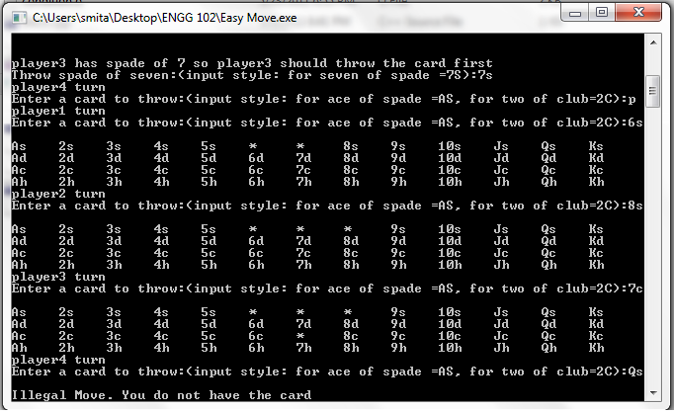
Methodologies

Slide 10
GRAPHICS
USED
FOR
PROJECT

Slide 11
Allegro (Library Function)
Allegro is a cross platform , open source , game programming libraries, primarily for C and C++ .
Uses to create windows
For accepting user inputs
loading data
Drawing images
Playing sound.

Slide 12
Function Used in Allegro
BITMAP *Variable;
Load_bitmap.
For loading image file.
Blit function.
For displaying images.
Mouseinside function.
For mouse click button.
Load_sample function.
For loading sound file.
Play_sound function.
For playing sound.
SAMPLE *Variable;

Slide 13
Supports And Requirement`
Uses images of bmp or pcx format.
Uses sound of wave, midi format.
Install graphics.
Install mouse.
Install sound.

Slide 14
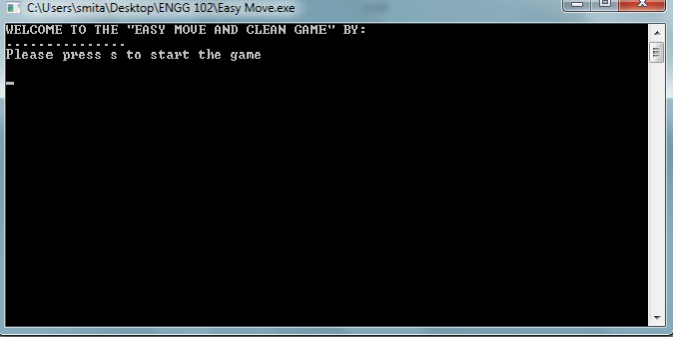
CUI Interface Of The GAME Main menu

Slide 15
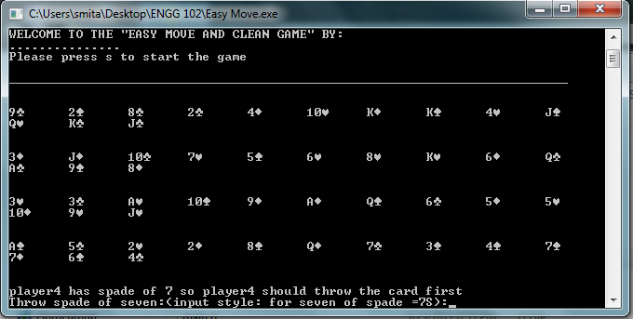
Game Interface

Slide 16
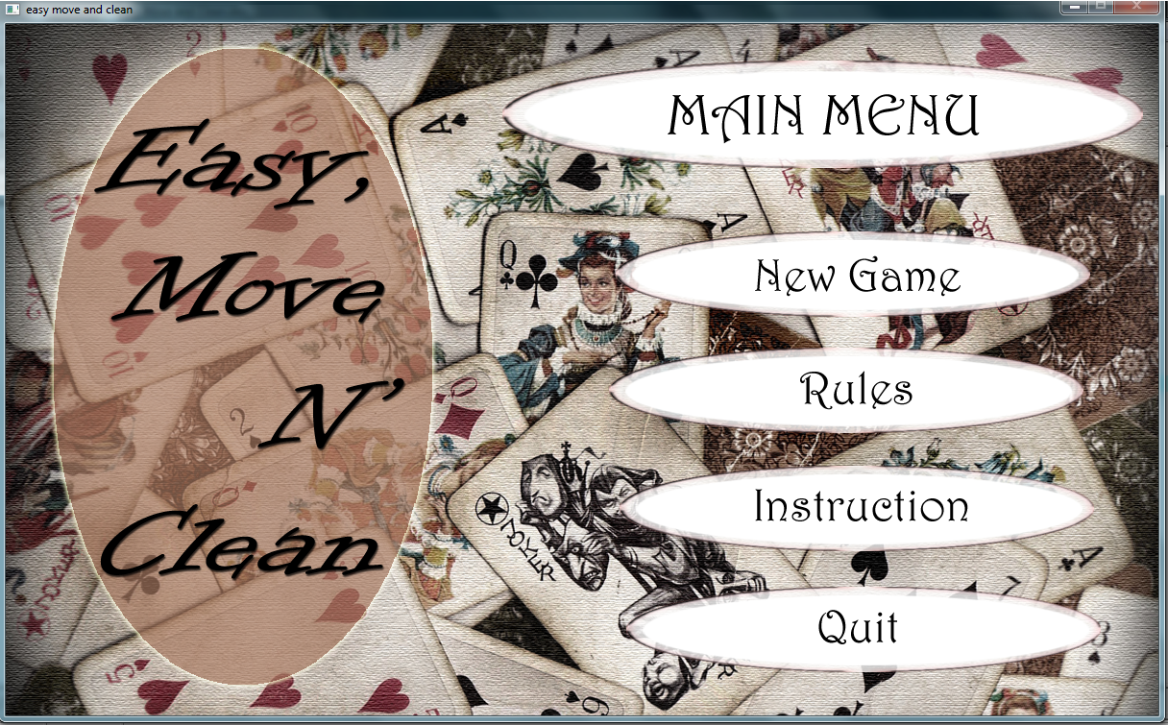
GUI Interface (Using Alllegro) Main Menu
THE GRAPHICS IS MUCH MORE ADVANCE.

Slide 17
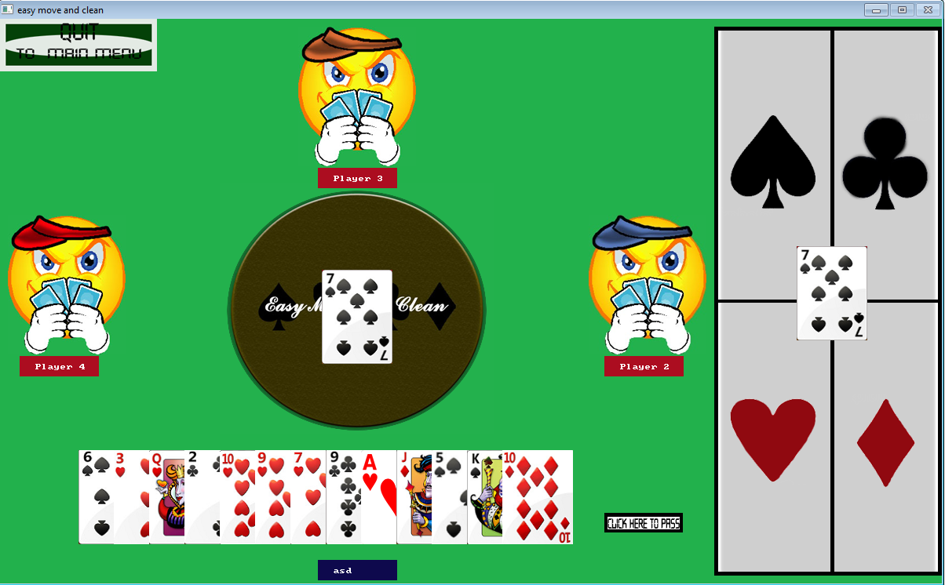
Game Interface

Slide 18
DEVELOPMENT
FULL PROJECT WITH MOUSE
FUNCTIONALITY.
ADDING CONDITIONS, SOUNDS AND GRAPHICS
ADDING IMAGES AND TEXTS
PROJECT WITHOUT ALLEGRO

Slide 19
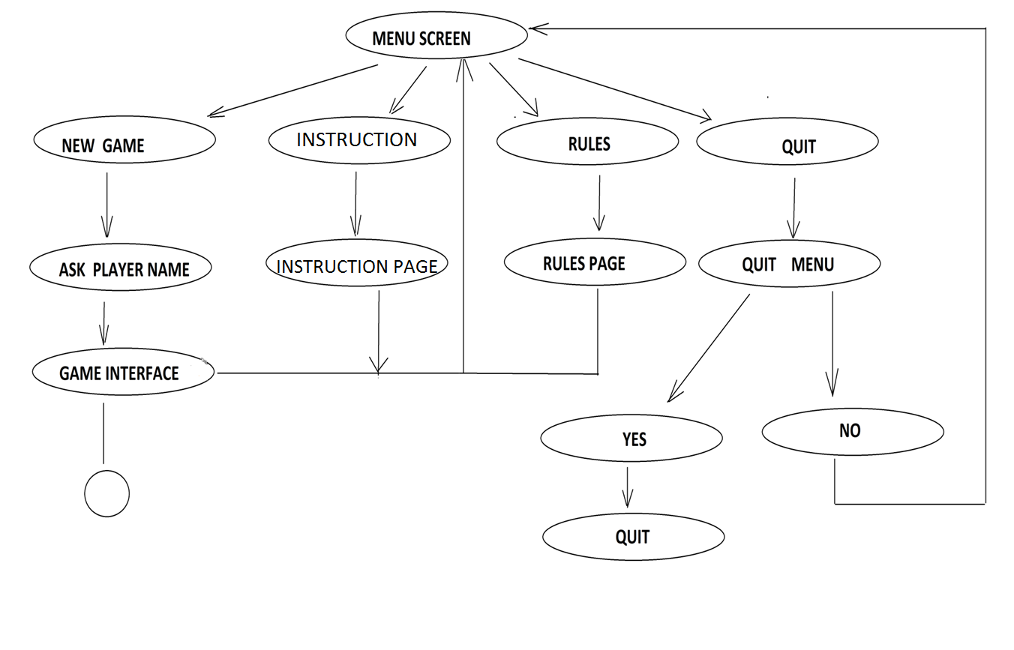
Data Flow Diagram

Slide 20
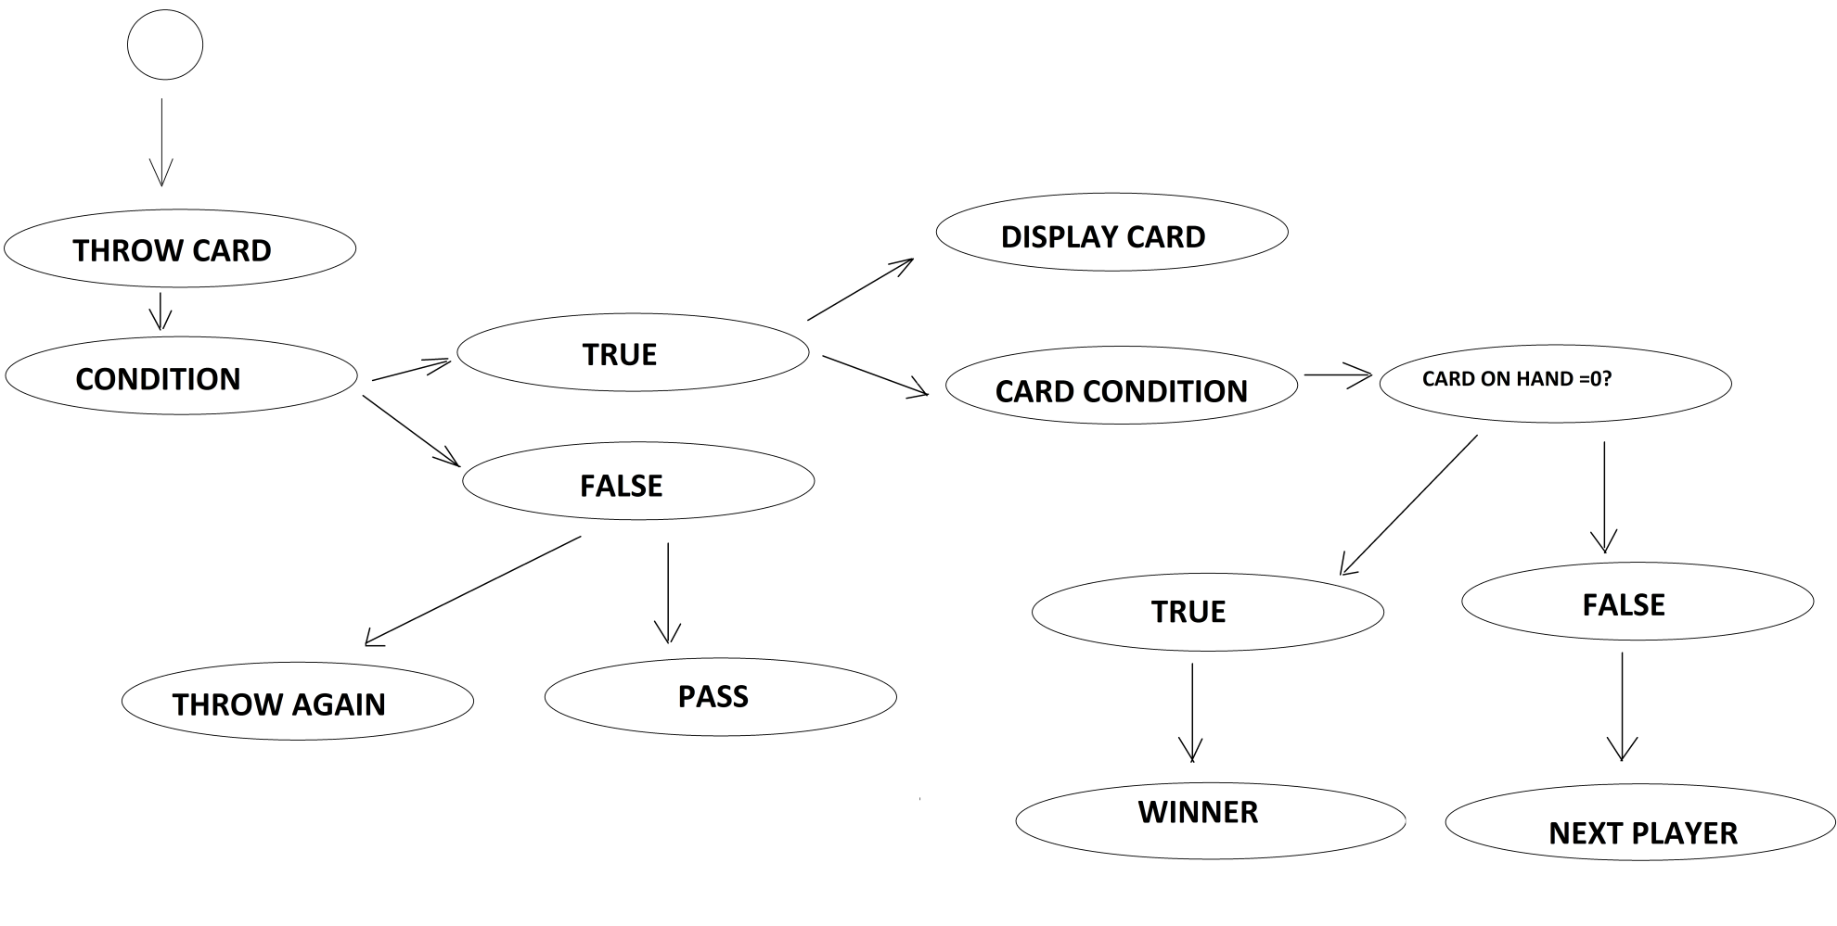

Slide 21
LANGUAGE AND TOOLS USED
Used a programming language called C++ with the IDE(Integrated development environment) named DEV C++ with the GUI “Allegro”.
Packages used:
MinGW runtime (creating windows application)
Windows 32 API
WinBGIm (including graphics)
GNU Debugger.
gcc-g++

Slide 22
TOOLS
ADOBE PHOTOSHOP FOR DESIGNING IMAGES(BITMAPS),MENU SCREEN,RULE SCREEN AND CARDS
SOUNDS WERE DESIGNED ANND CONVERTED BY TOTAL AUDIO CONVERTER.

Slide 23
Expansion
Lan game play.Connecting up to 4 computer.
Bot skill level.

Slide 24
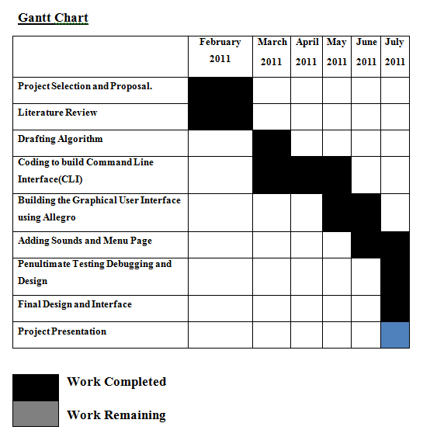

Slide 25
Conclusion
-Concepts of OOP were gained
-Modular programming practised
-Teamwork and collaboration

Slide 26
DEMO

